Slide 1
Chapter Six
Tree structure

Slide 2
Contents
Trees, binary trees and binary search trees
Implementing binary trees
Searching a binary tree
Tree traversal
Insertion
Deletion
Balancing a tree

Slide 3
Tree
A tree is a set of nodes and edges that connect pairs of nodes.
It is an abstract model of a hierarchical structure.
A tree consists of a number of nodes connected by arcs.
Unlike a real tree, tree data structures are typically depicted upside down, with the root at the top and the leaves at the bottom.
Each node can have a number of child nodes, and the parent and child nodes are connected by arcs.
The root node is the top node that has no parent nodes. The leaves of the tree are those that have no child nodes.

Slide 4
Cont..
A path to a node is a sequence of arcs that connect the root to the node.
The length of a path is the number of arcs in the path.
The level of a node is equal to the length of the path from the root to the node plus 1.
The root node is said to be at level 1 of the tree, its children at level 2, and so on.
The height of a tree is equal to the maximum level of a node in the tree.
For example (figure on previous slide), Figure a has a height of 2, Figure b and Figure c have heights of 4, and Figure d has a height of 6.
Trees can be useful data structures as they often express the structure of real world information more accurately.

Slide 5
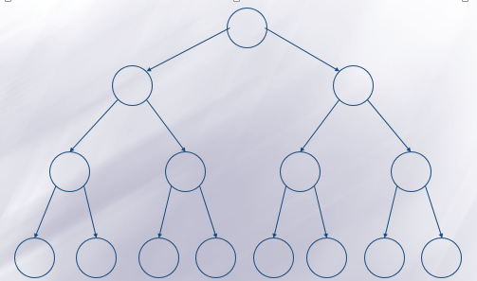
Binary tree
A binary tree is a tree whose nodes have at most two children each: a left child and a right child.
Nodes can have a single child (either left or right), or they can have no children, but they can never have more than two children.
Full binary tree: is a binary tree where each node has either zero or two children.
Balanced Binary Tree: where each node except the leaf nodes has a left and right children and all the leafs are at the same level.

Slide 6
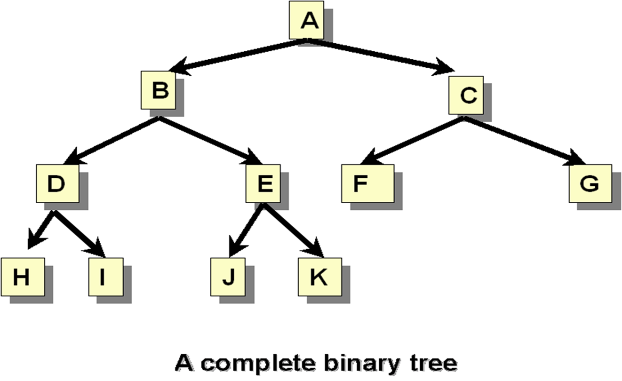
Cont..
Complete Binary Tree: is a binary tree in which the level of any leaf node is either H or H-1 where H is the height of the tree. The deepest level should also be filled from left to right.

Slide 7
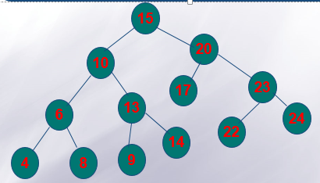
Binary Search Tree/Ordered Binary Tree
It is a binary tree which can be empty or satisfies the following:
Every node has a key and no two nodes have the same key
The keys in the right subtree are larger than the keys in the root
The keys in the left subtree are smaller than the keys in the root
The left and right subtrees are also binary search trees.

Slide 8
Data structure of Binary Tree
struct datamodel{ datafield declaration;
datamodel *left, *right;
};
datamodel *rootpointer=NULL;

Slide 9
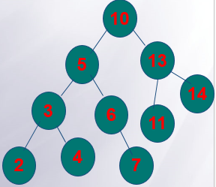
Operations on Binary search tree
Consider the following structure
struct Node{ int num;
Node *left, *right;
};
Node *rootnodeptr=NULL;

Slide 10
Operations on Binary search tree
Insertion
To insert a node (pointed by new node pointer) in to a binary search tree (whose root node is pointed by rootnodeptr)
If the tree is empty, the node to be inserted is made the root node.
Otherwise, search the appropriate position and insert the node (fore example, to insert newnodeptr 8, compare rootnodeptr not null then compare 8 with 10, since 8<10 go to left compare 8 with 5, since 8>5, go to right, compare 8 with 6, since 8>6, go to right, compare, final compare 8 with 7 and since 8>7 and right of 7 is null, 8 will be inserted to the right of 7)

Slide 11
void insert(int d){
tree *newnode= new tree;
newnode->data=d;
newnode->left=NULL;
newnode->right=NULL;
tree *temp=root;
int flag=0;
if(root==NULL)
temp=root=newnode;
else{
while(flag==0){
if(temp->data > newnode->data){
if(temp->left==NULL){
temp->left=newnode;
flag=1;}
else
temp=temp->left; }
else{
if(temp->right==NULL){
temp->right=newnode;
flag=1;}
else
temp=temp->right; }
}//while loop
} }//function

Slide 12
Node Searching
Searching a binary search tree is not dissimilar to the process performed when inserting an item:
Compare the item that you are looking for with the root,
and then push the comparison down into the left or right sub-tree depending on the result of this comparison, until a match is found or a leaf is reached.
This takes at most as many comparisons as the height of the tree.
At worst, this will be the number of nodes in the tree minus one.

Slide 13
Implementation
Function call:
elementExists=searchBST(RNP, number);
The function (recursive implementation)
bool searchBST(Node *CurrNodeptr, int x)
{
if(currNodeptr==NULL)
return (false);
else if (currNodeptr->num==x)
return (true);
else if (currNodeptr->num>x)
return (searchBST(currNodeptr->left, x);
else
return (searchBST(currNodeptr->right, x);
}

Slide 14
Alternatively
The function call
searchedNodeptr=searchBST(RNP, Number);
The function (recursive implementation)
Node* searchBST(Node *CurrNodeptr, int x)
{
if(currNodeptr==NULL)
return (NULL);
else if (currNodeptr->num==x)
return (currNodeptr);
else if (currNodeptr->num>x)
return (searchBST(currNodeptr->left, x);
else
return (searchBST(currNodeptr->right, x);
}

Slide 15
Deletion
Deletion of a node from a binary search tree can be more difficult. The difficulty of the operation depends on the position of the node in the tree. There are three cases:
The node is a leaf. This is the easiest case to deal with. The appropriate pointer of its parent is set to null and the node deleted
The node has one child. This case is also not complicated. The appropriate pointer of its parent is modified to point to the child of the node(the child node takes the place of its parent → the node to be deleted)
The node has two children. This one is a bit complicated. There are two possible ways of dealing with this situation. They are Deletion by Merging and Deletion by Copying.

Slide 16
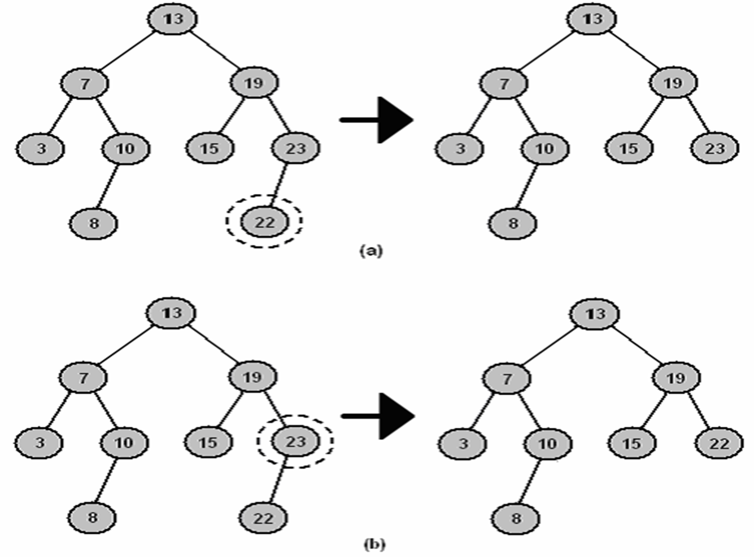
Cont..

Slide 17
Deletion by Merging
One way of deleting nodes that have two children is called deletion by merging.
This algorithm works by merging the two subtrees of the node and attaching the merged tree to the node’s parent.
In binary search trees, every value in the left subtree is less than every value in the right subtree, so if we can find the largest value in the left subtree, then we can attach the right subtree as the right child of this node, and still preserve the ordered nature of the tree.
This process is illustrated in the following figure.
To find the largest value in the left subtree we need only keep tracking the right child pointer until a null is encountered.
Symmetrically, this algorithm can also work by finding the smallest value in the right subtree, and attaching the left subtree to it.

Slide 18
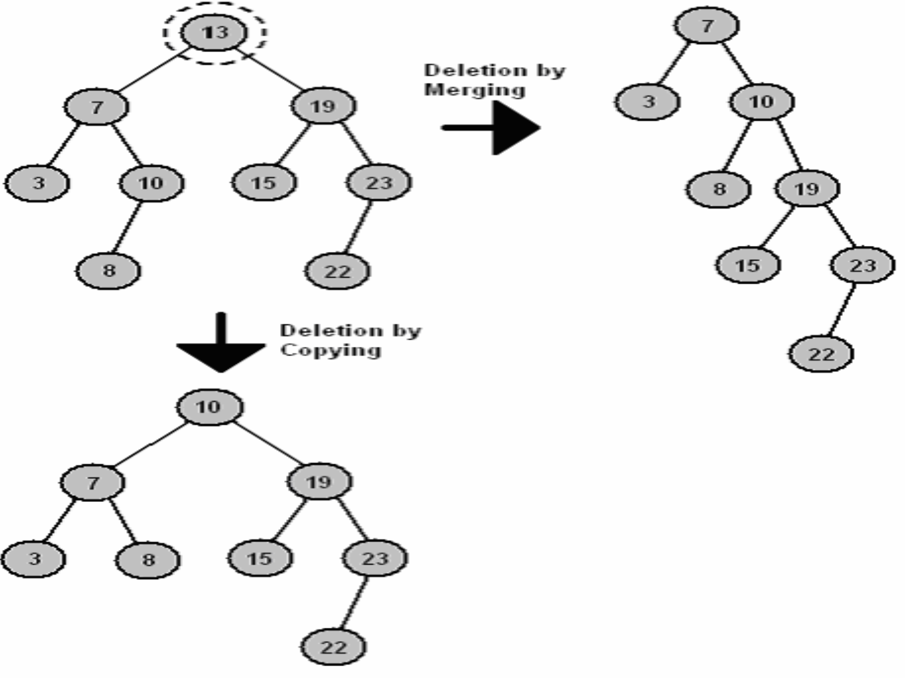
Cont..

Slide 19
Deletion by Copying
Deletion by copying works in a similar fashion to deletion by merging.
First, we find the largest value in the left sub-tree.
Next, we copy this node, so that it replaces the node being deleted.
This process is illustrated in the above figure. The 10 node is a valid new root to the tree because it is greater than all nodes in the left sub-tree, and less than all nodes in the right sub-tree.
A slight complication with this algorithm can occur if the largest value in the left subt-ree has a left child.
In this case, the left child is attached to the nodes parent instead.
For example, in above Figure the 10 node had a left child (node 8), so it was attached as the right child of 10’s parent, namely 7.

Slide 20
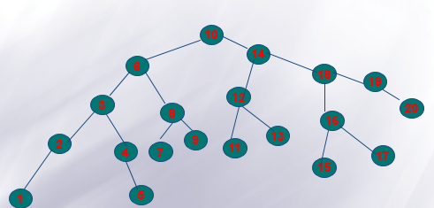
Exercise
From the above binary search tree considering independently,
Give the tree after node 1 is deleted.
Give the tree after node 2 is deleted.
Give the tree after node 6 is deleted (Deletion by merging)
Give the tree after node 10 is deleted (Deletion by Coping).

Slide 21
Tree Traversal
Compared to linear data structures like linked lists and one dimensional arrays, which have only one logical means of traversal, tree structures can be traversed in many different ways.
Starting at the root of a binary tree, there are three main steps that can be performed and the order in which they are performed define the traversal type.
These steps are: Performing an action on the current node (referred to as "visiting" the node); or repeating the process with the subtrees rooted at our left and right children.
Thus the process is most easily described through recursion.

Slide 22
Traversal methods
To traverse a non-empty binary tree in preorder, we perform the following three operations:
1. Visit the root. 2. Traverse the left sub-tree in preorder. 3. Traverse the right sub-tree in preorder.
To traverse a non-empty binary tree in inorder, perform the following operations:
1. Traverse the left sub-tree in inorder. 2. Visit the root. 3. Traverse the right sub-tree in inorder.
To traverse a non-empty binary tree in postorder, perform the following operations:
1. Traverse the left subtree in postorder. 2. Traverse the right subtree in postorder. 3. Visit the root. This is also called Depth-first traversal.
Finally, trees can also be traversed in level-order, where we visit every node on a level before going to a lower level. This is also called Breadth-first traversal

Slide 23
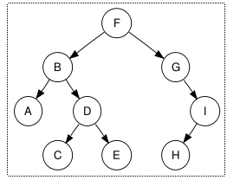
Cont..
Preorder traversal
F, B, A, D, C, E, G, I, H
In-order traversal
A, B, C, D, E, F, G, H, I
Note that the in-order traversal of a
binary search tree yields an ordered list.
Postorder traversal
A, C, E, D, B, H, I, G, F
Level-order traversal
F, B, G, A, D, I, C, E, H

Slide 24
Implementations
Implementation of preorder
void preorder(Node *currNodeptr){
if(currNodeptr!=NULL){
cout<<currNodeptr->num;
preorder(currNodeptr->left);
preorder(currNodeptr->right);
}
}
Implementation of Inorder
void inorder(Node *currNodeptr){
if(currNodeptr!=null){
inorder(currNodeptr->left);
cout<<currNodeptr->num;
inorder(currNodeptr->right); }
Implementation of postorder traversal
voidpostorder(Node currNodepptr){
if (currNodeptr!=NULL){
postorder(currNodeptr->left);
postorder(currNodeptr->right);
cout<<currNodeptr->num;
}
}

Slide 25
Balancing a Tree
if a tree becomes unbalanced, the efficiency of search operations using that tree can be affected
A tree is perfectly balanced if it is balanced and/or all leaves are to be found on one or two levels.
How to balance an unbalanced tree?
Often trees become unbalanced because of the order in which data arrives.
One technique to ensure trees become balanced is to change the order in which values are added to the tree.
This can be achieved by storing all values in a linear data structure such as an array as they arrive.
When all values have arrived they can be added to the tree in such an order that leads to a well-balanced tree.

Slide 26
Cont..
The disadvantage of this algorithm is that it requires the arrival of all values before we can start to use the tree.
This is not always possible. It is always possible to use inorder traversal to transfer the data from the tree to an array, and then recreate the tree using the algorithm above.

Slide 27


Example
The first node to be added to the tree is the middle element of the array, in our case 12. This effectively divided the array into two.
Next, we recursively build two subtrees based on the two remaining halves of the array.
Dealing only with the left half, the next node to be selected is 7. Again, this divides our array into two halves:
The left half now consists of a single element, so this is added to the tree and we process the right half.

Slide 28
Cont..
This consists of the values 8 and 10, so these are also added to the tree.
This process continues until all nodes have been added. In our case, the values will be added to the tree in the following order.
The balanced tree

